Slide 1

MASTER OF TEACHING (SECONDARY)
Welcome Session – 2025
Assoc. Prof. Garth Stahl
(Director Sec. Programs)
CRICOS Provider Number 00025B

Slide 2

Acknowledgment of Country
  The University of Queensland (UQ) acknowledges the Traditional Owners and their custodianship of the lands on which we meet.
  We pay our respects to their Ancestors and their descendants, who continue cultural and spiritual connections to Country.
  We recognise their valuable contributions to Australian and global society.
Notes:
Guidelines for use:
Use this slide when presenting at UQ or at any site in Australia, when appropriate.
Remember to pause briefly after acknowledging Country as a sign of respect.
If you are more familiar with acknowledging Country you may add a statement about the event, meeting or forum’s connection with Country.
For example; at a higher education event you might acknowledge that the campus has always been a space for teaching, learning, research and collaboration tens of thousands of years before it was established as a university campus, and continues today.
When to use longer version:
If you are the main speaker at the event/gathering
If you are the first person to present.
When to use a shorter version:
If you are not the first person to acknowledge Country
In a more informal setting
Thanking a Traditional Owner for welcoming people to Country.
Longer version
I acknowledge the Traditional Owners and their custodianship of the lands on which we meet today. (On behalf of *) I pay our respects to their Ancestors and their descendants, who continue cultural and spiritual connections to Country. We recognise their valuable contributions to Australian and global society.
* If you are hosting an event, meeting or seminar, you might say something like “On behalf of the event organisers or your section….”
Shorter version
I (too,) acknowledge the Traditional Owners and their custodianship of the lands on which we meet today and pay my respect to their Ancestors and their descendants.
Slide last updated June 2019 – content owner is PVC(IE)/ATSISU (contact Nell Angus).

Slide 3

We are so glad you are here

Slide 4
Pointers
Get to know your instructors
Be an active learner
Ask when you don’t understand
Question to further thinking
Take advantage of the services/offerings at UQ
ATTEND CLASSES!!!

Slide 5
What’s happening today?
Welcome
Understanding your program structure
Preparing for your courses
Settling into university life

Slide 6
1. Welcome

Slide 7
School Staff
Head of School Professor Robin Shields
Deputy Head of School Associate Professor Marnie Shay
Director of Teaching and Learning Associate Professor Carmen Mills
Director of Primary Preservice Programs Dr Emily Ross
Course Coordinators Various
Director of Professional Experience Dr Stevie-Jae Hepburn
Professional Staff Team Laura Rouse
General Enquiries education@uq.edu.au
07 3365 6550

Slide 8
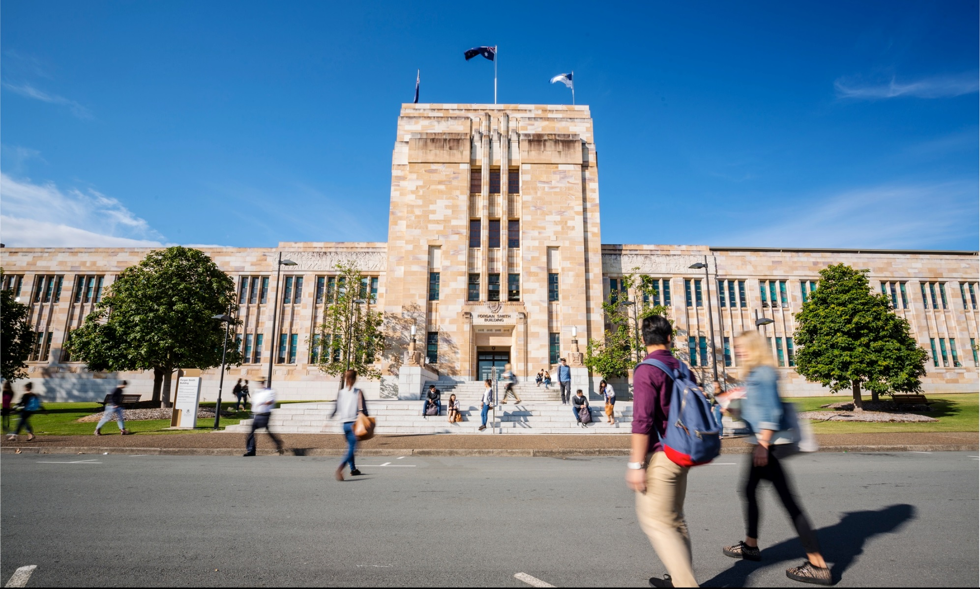
TERMINOLOGY
COURSE | e.g. EDUC7600, EDUC7605, EDUC7510
UNIT | Weighting for a course, e.g. #2
TEACHER PREPARATION PROGRAM | Program/degree which provides the qualifications to apply for teacher registration
PRE-SERVICE TEACHER | A student studying a teacher preparation program
PROFESSIONAL EXPERIENCE | Practicum/placement/prac.

Slide 9
Course & Program Related Terminology
HASS = Humanities Arts and Social Sciences (our Faculty)
Faculty = Home of related Schools eg: Humanities and Social Sciences
School = Home of related study areas eg: School of Education
Program = Degree or study area eg: Bachelor of Arts
Major/Plan = Study Areas eg: History, French
Course = Subject/Class eg: PHSS2000
Unit (#) = Value of the course eg: 2 (almost always 2)
Semester = Duration of courses eg: approximately 13 weeks

Slide 10



Welcome to the profession
Why do you want to be a teacher?

Slide 11
Important dates
January 28 – 9am
My Timetable preferencing closes Semester 1 2025
February 17 - 21
Orientation Week Semester 1 2025
February 24
Classes commence Semester 1 2025
March 7
Last day to add a course or alter enrolment for Semester 1 2025
March 31
“The Census Date”
Last date to drop Semester 1 2025 courses or cancel enrolment without financial liability
April 30
Last date to drop Semester 1 2025 courses or cancel enrolment without academic penalty
https://about.uq.edu.au/academic-calendar

Slide 12
2. Understanding your program structure

Slide 13

UQ Portals
mySi-net: enrolment, dropping courses, fee information, semester grades, GPA etc.
Allocate+ : class sign-on, timetable
Blackboard (e-learning): School of Education community noticeboard, important course announcements, individual assessment grades etc.
TurnItIn: assessment submission (unless otherwise specified, e.g. prac. reports through blackboard)
Electronic Course Profiles (ECPs): Courses and Programs website, provides course outline, learning resources, assessment information, course coordinator contact details etc.
MyUQ: Access to student email account – check regularly!
School of Education website: https://education.uq.edu.au/

Slide 14
Program Enrolment Pattern
Your program is not a collection of random courses haphazardly thrown together!
Follow the program structure!!!
Your entire program is mapped against the Australian Professional Standards for Teachers (APST) graduate standards.
The APST comprises 37 individual standards contained within 7 overarching standards.
Each standard is explicitly addressed in coursework throughout your program of study.

Slide 15
YOUR PROGRAM
Important notes about your program
- You must meet a set of program rules - official rules are on the Courses and Programs website: www.uq.edu.au/study
- You are governed by the rules for the year that you commenced the program (i.e. 2025)
- Education degree ‘owned’ and managed by HASS
- You can access Master of Teaching rules/study plan by searching ‘UQ Programs and courses’ (https://my.uq.edu.au/programs-courses/)and inputting ‘Master of Teaching Secondary’

Slide 16
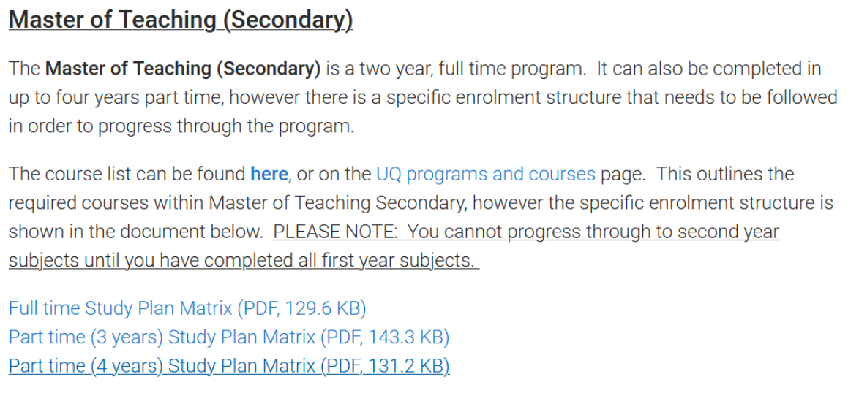
https://education.uq.edu.au/current-students/student-resources

Slide 17
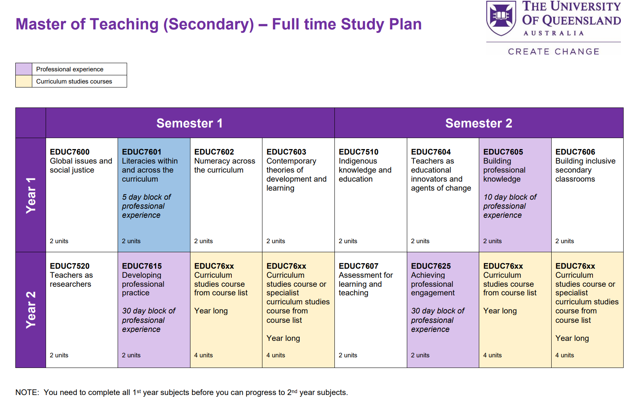
PROGRAM STRUCTURE
Notes:
Year 1 is the foundation year of the program, comprised of core courses and professional experience opportunities.
These courses provide opportunities for preservice teachers to see the relevance of these core courses for their curriculum area, introduce relevant syllabus documents and curriculum specific considerations early in the program, and facilitate engagement with other preservice teachers who will be teaching in a related area.
In Year 2, preservice teachers undertake core courses in assessment and research; their 2 x year-long double credit curriculum studies courses, and two extended professional experience placements.

Slide 18
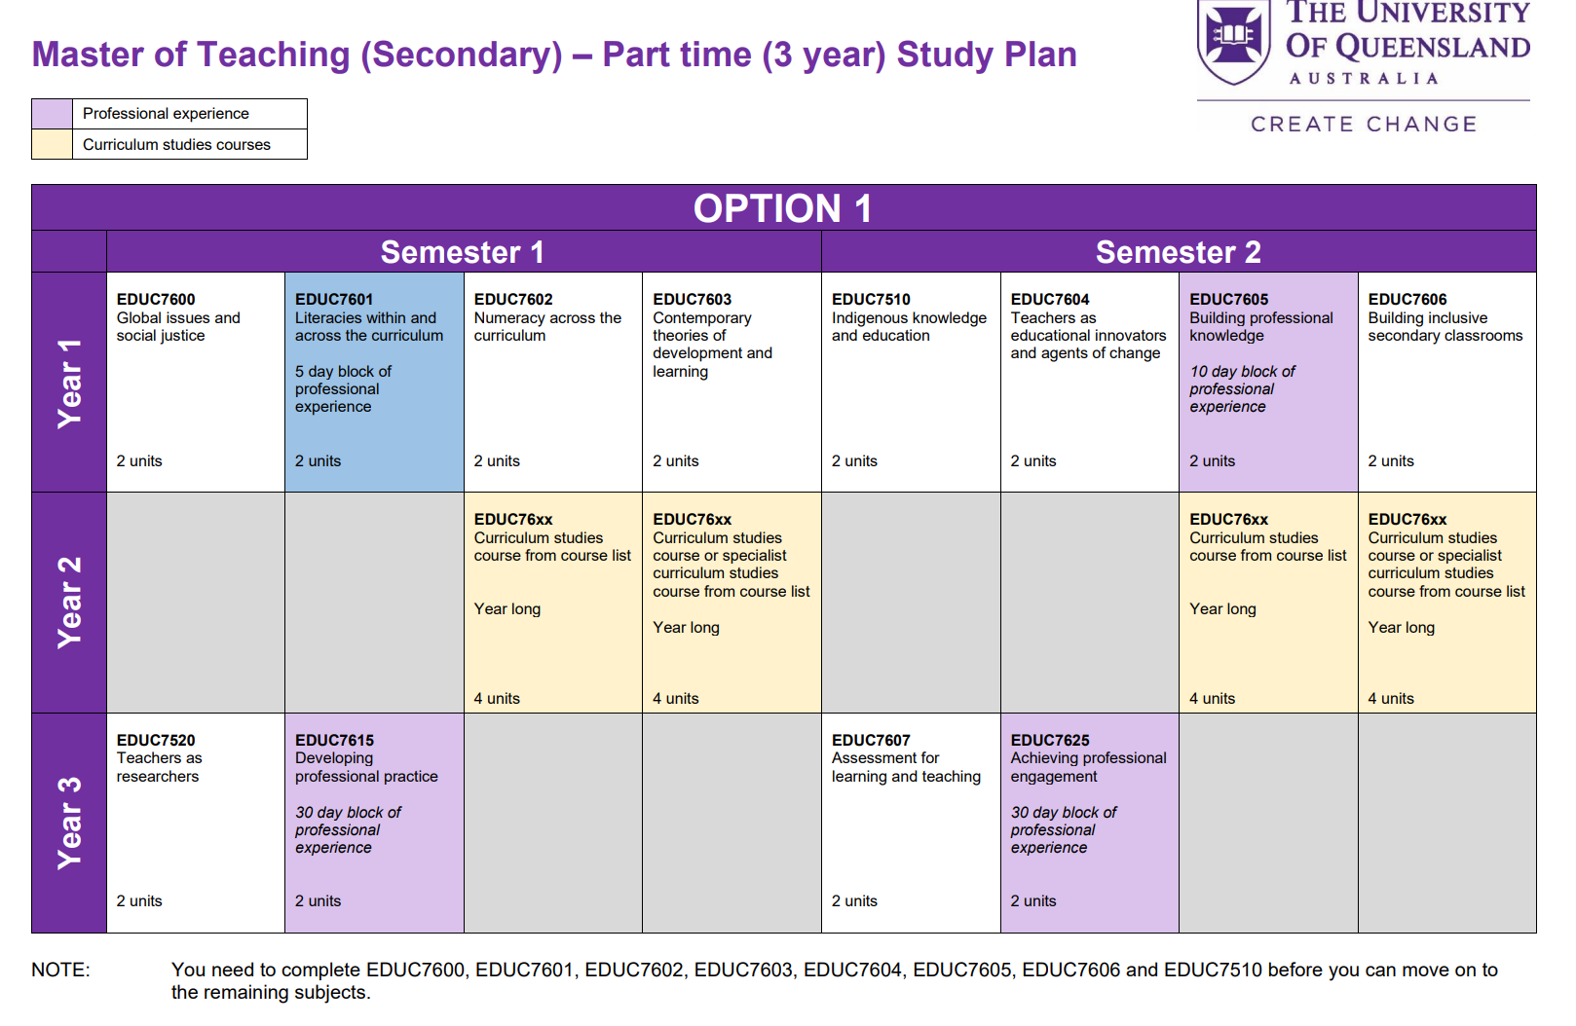
PROGRAM STRUCTURE
PART TIME – 3 year – Option 1

Slide 19
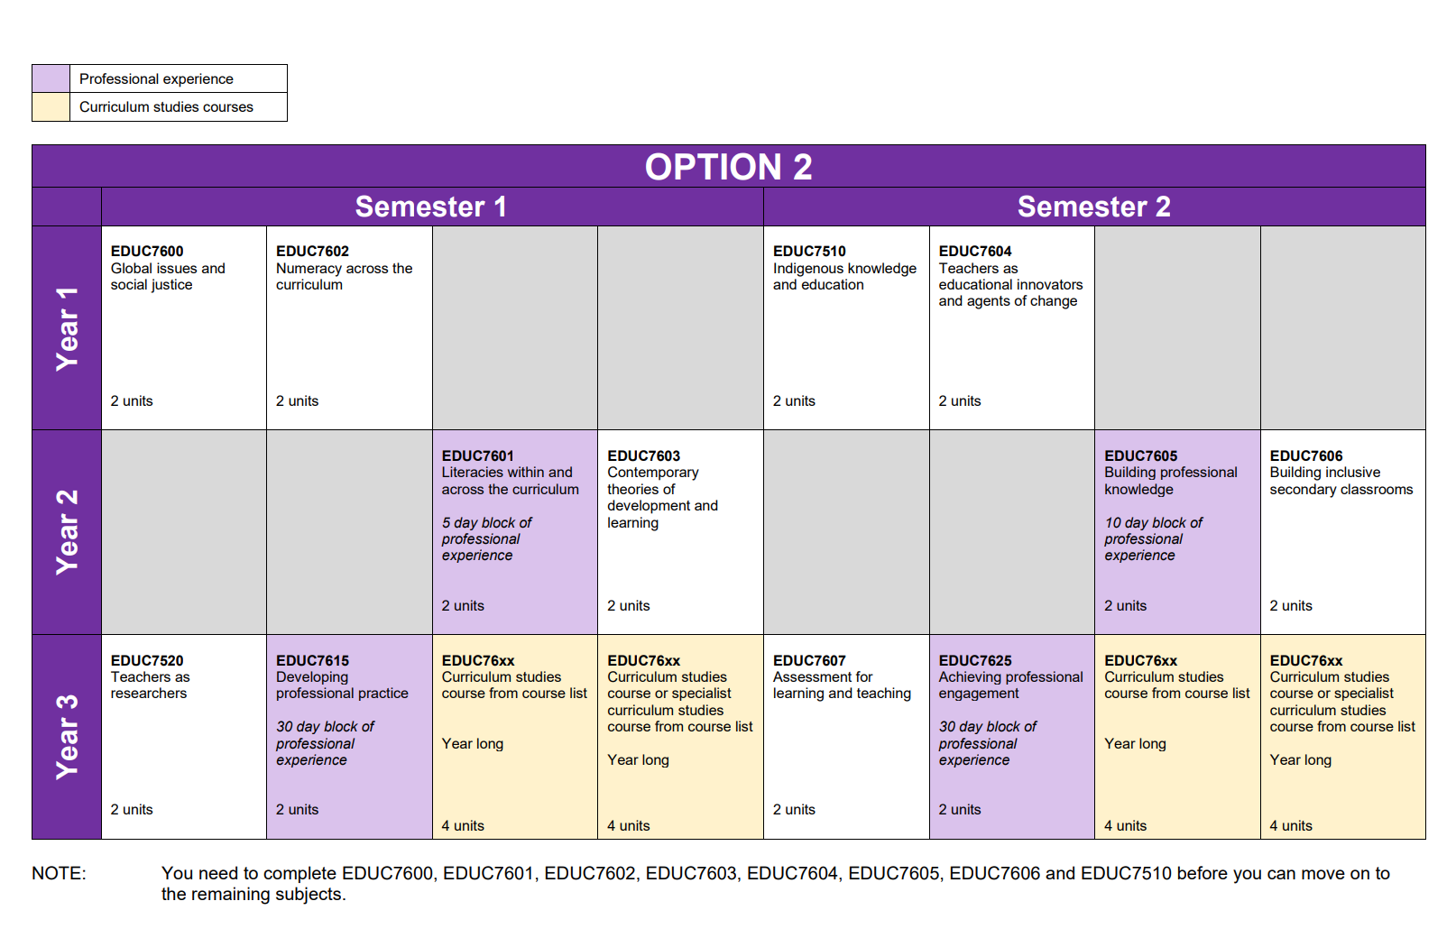
PROGRAM STRUCTURE
PART TIME – 3 year – Option 2

Slide 20
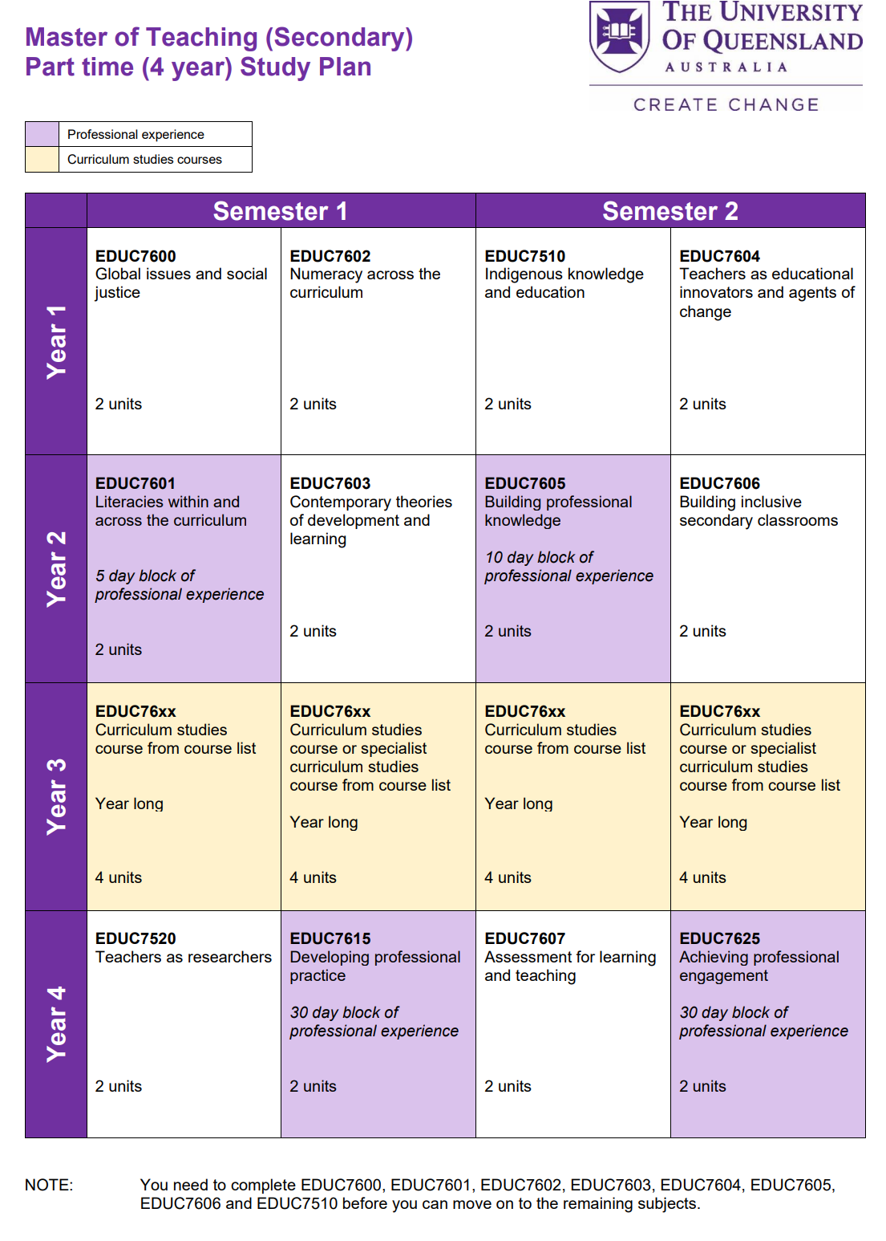
PROGRAM STRUCTURE
PART TIME – 4 year

Slide 21
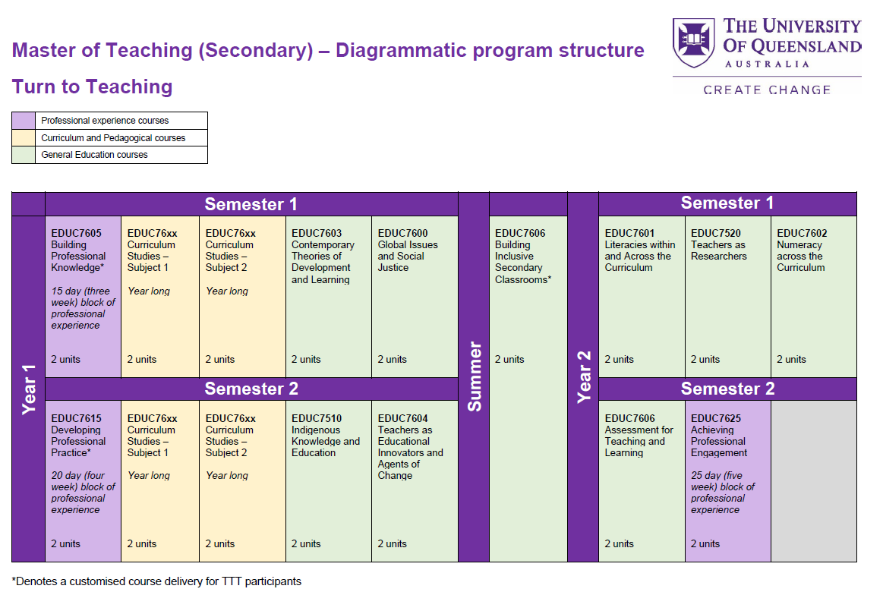
PROGRAM STRUCTURE
Turn to Teach

Slide 22

PROFESSIONAL EXPERIENCE THROUGHOUT YOUR PROGRAM

Slide 23
THE DEVELOPMENTAL CONTINUUM FOR PROFESSIONAL EXPERIENCE
EDUC7601
(Literacy Across the Curriculum)
Field Experience
1 Week Block (5 days)
Observation
EDUC7605
(Building Professional Knowledge)
Supervised Professional Experience
2 Week Block (10 days)
Observations and Segments of Lesson
EDUC7615
(Developing Professional Practice)
Supervised Professional Experience
6 Week Block (30 days)
Observation, segments of lessons and whole lessons
Year 1, Semester 2
EDUC7625
(Achieving Professional Engagement)
Supervised Professional Experience
6 Week Block (30 days)
Observation, segments of lessons and whole lessons
Year 2, Semester 1
Year 1, Semester 2
Year 1, Semester 1
During your second year you will be teaching in your curriculum area and specialist teaching areas
Notes:
The on-campus theoretical/conceptual foundations build and support each student’s professional experiences.
The Professional Experience components total 75 days across the two year program:
5 days in Semester 1, Year 1 – Field experience
10 days in Semester 2, Year 1 – Supervised & assessed
30 days in Semester 1, Year 2 - Supervised & assessed
30 days in Semester 2, Year 2 - Supervised & assessed
The supervised and assessed Professional Experience placements are developmental in nature, building from observations and teaching segments of lessons and then entire lessons in Year 1, to more substantial and sustained teaching experiences in Year 2, culminating in the final Professional Experience placement, the completion of the Graduate Teacher Performance Assessment and the opportunity to demonstrate achievement against the Graduate Teacher Standards.

Slide 24
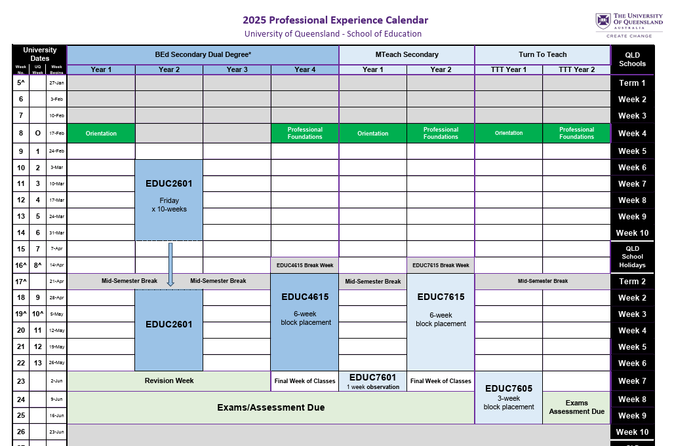
2025 Professional Experience Calendar
Available on the School of Education website.
A great resource that will help you plan each year!
Link to calendar:
https://education.uq.edu.au/files/20827/2025%20Teacher%20Preparation%20Calendar%20-%20Secondary.pdf

Slide 25
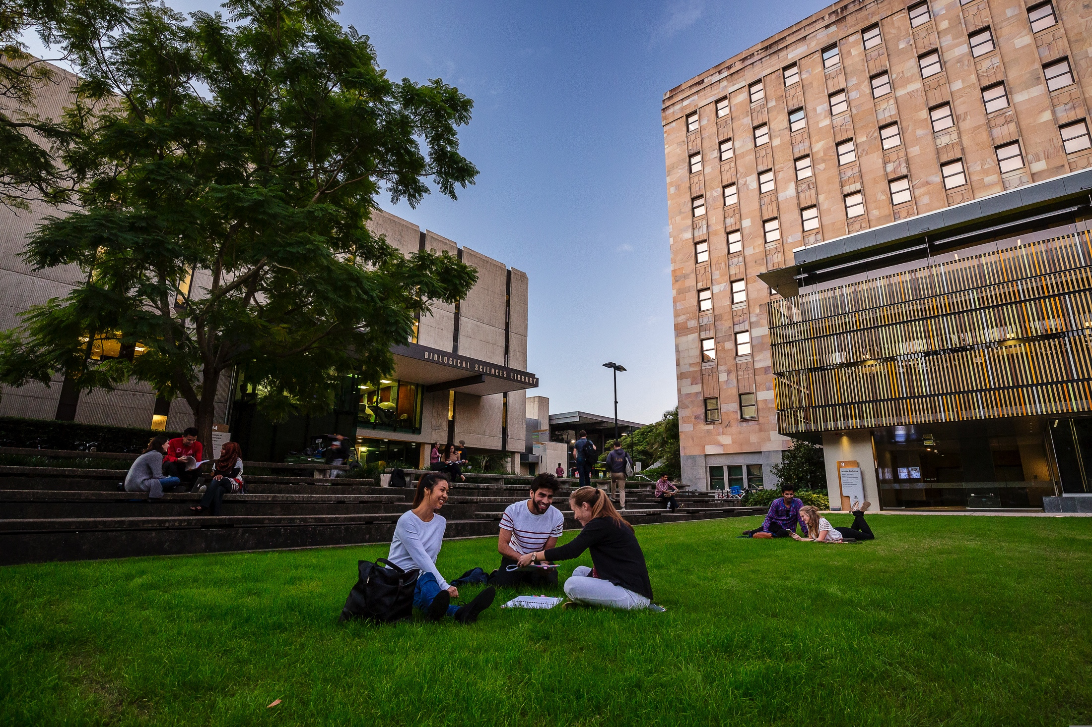
ORGANISATION OF PROFESSIONAL EXPERIENCE
The School of Education Placement Officers organise ALL professional experience placements
The University is governed by an Industrial Agreement where students are NOT to organise their own placements
CRICOS Provider Number 00025B

Slide 26
Key important features – Professional Experience (PEx)
Registering for PEx – https://my.uq.edu.au/information-and-services/manage-my-program/placements
or find it on your my.UQ dashboard.
Your placement is based on the following data:
Your current suburb and street address recorded on your InPlace Registration page, which may differ from your SINET TERM address
Your mode of transport – ticking public transport does not necessarily mean a closer school.
You may be required to travel 90 minutes by public transport
Your interest in attending faith-based schools (Catholic Education, Lutheran, etc)
Conflict of Interest
Once verified, your details cannot be changed without an email to education@uq.edu.au
Please update your InPlace registration page with the above information ASAP. For more information, visit: https://education.uq.edu.au/professional-experience-pex
> Information for Students > InPlace Student Registration Details

Slide 27
Key important features – Professional Experience
Rural and remote placements are encouraged where possible
Information on Regional, Rural & Remote placements is also available on our website: https://education.uq.edu.au/professional-experience-pex
> Information for Students > Regional, Rural & Remote PEx Placements (RRR).
Financial assistance for State School placements can be applied for through a Regional Professional Experience Grant and Beyond The Range Professional Experience Grant
via Teach Queensland: https://teach.qld.gov.au/scholarships-and-grants/beyond-the-range-professional-experience-grant
Paid Prac options – please see the UQ website: https://study.uq.edu.au/stories/commonwealth-prac-payment
  More information is available on the Australian Government website

Slide 28
Organisation of Professional Experience
The School of Education Placement Officers organise ALL professional experience placements.
We do not collect individual preferences. Exceptional circumstances will be considered on a case-by-case basis.
The University is governed by an Industrial Agreement where students are NOT to organise their own placements.
Each student must read and agree to abide by the Professional Experience Policies and Procedures document prior to every professional experience.
If adjustments need to be made to the placements, it is recommended you book at appointment with a Student Advisor as soon as possible (https://my.uq.edu.au/make-appointment-student-adviser)
Notes:
The only funding currently available is through Teach Queensland, being the Regional Professional Experience Grant and Beyond The Range Professional Experience Grant.
There was previously a small bursary for students completing a Regional placement from School of Education, however I am not sure if that will be available in 2024. It was an anonymous donor and funding coordinated by Tisha.
There is also a SEED grant, this grant is administered by UQ Student Enrichment and Employability Development (SEED) and we do not know how much the grant will be, it varies each semester.

Slide 29
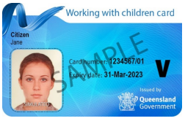
Key important features – Blue Cards
Student’s responsibility to check the renewal
date
Must carry the card on you at all times when on placements or visiting schools
Failure to have a valid Blue Card can result in large fines for the University, the School and the student
No Blue Card = No prac!
All students must have a valid Blue Card for the duration of each placement.
Applications, renewals and cards from other organisations must be registered/applied for via the blue card online application portal: see instructions on the School of Education page https://education.uq.edu.au/our-students/blue-card-information
Remains current for three years

Slide 30
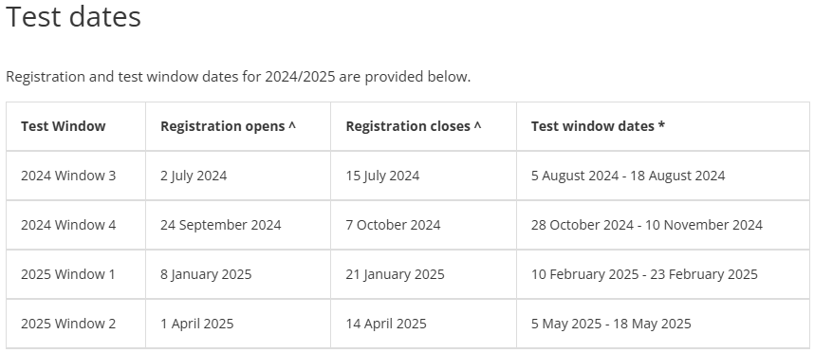
Key important features – LANTITE
Facilitated by ACER - Initial teacher education students’ personal literacy and numeracy skills to ensure teachers are well equipped to meet the demands of teaching.
All preservice teachers must meet the benchmark of both LANTITE tests to be eligible to graduate. See link below for 2025 test dates: https://teacheredtest.acer.edu.au/register/test-dates. Students who are proficient in First Nations language may be exempt (see School of Education website for more details).
YOU MUST TAKE THE LANTITE TEST IN YOUR FIRST YEAR
Notes:
The first three windows of 2024 (up to August 2024) are part of an important LANTITE trial.
For the duration of the trial (four test windows), enrolled ITE students in all states or territories will be able to have uncapped attempts. This means that candidates who attempt the test during the trial will not have their failed attempts recorded as attempts when the trial ends. If you meet the test standard during the trial, it will count for the purpose of meeting the standard.
If you attempt the test during the trial, you will also receive improved feedback in the form of a Described Proficiency Scale that describes skills tested and outlines skills required to achieve better results and progress from one band to the other.
To take advantage of uncapped test attempts during the trial, simply register for the test window you wish to sit.

Slide 31
Reminder: Academic Integrity Modules (AIM)
Please complete the Academic Integrity Modules.
Part A by Census date (31 March 2025) and Part B by the end of Week 13. Student results will not be released until the modules have been completed.
https://web.library.uq.edu.au/library-services/it/learnuq-blackboard-help/academic-integrity-modules
31

Slide 32
3. Preparing for your courses

Slide 33



Important terms
Your University
Central
Faculty
School
Your Degree
Program
Plan
Minor
Major
Extended major
Your Courses
Course
Compulsory
Elective
Unit
ECP
Blackboard

Slide 34
Course enrolment & tutorial sign-on
Textbooks
Wait until Week 1 to work out what textbooks you should get
Buy: The School Locker or UQ Union Second Hand Textbooks (https://www.uqusecondhandtexts.com/ )
Print: UQ Print
Borrow: UQ Library
Remember: Many books/texts are available as e-books through the library.
Log into Starting at UQ. Go to mySI-net to enrol in courses.
Once you are enrolled in a course, you should be able to see if tutorial sign-on is required. If not, this will be covered in your first lecture.
If you have a problem with sign-on, email your school admin team.

Slide 35
UQ Portals
MyUQ – Access to everything:
  student email account – check regularly!
  mySi-net: enrolment, dropping courses, fee information, semester grades, GPA etc.
  Allocate+ : class sign-on, timetable
  Blackboard (e-learning): School of Education community noticeboard, important course announcements, individual assessment grades etc.
    Turnitin: assessment submission (unless otherwise specified, e.g. prac. reports through Blackboard)
  Electronic Course Profiles (ECPs): Courses and Programs website, provides course outline, learning resources, assessment information, course coordinator contact details etc.

Slide 36
4. Settling into university life

Slide 37
Student Services (Central UQ)
Learning Assistance
Disability Support
Counselling Services
International Student Services
Careers & Employment Services
Accommodation
Multi-faith chaplaincy
Lots of workshops for skill development & support
ALL FREE!

Slide 38
Top 5 tips from Final year students
Attend your lectures and tutorials!
Make friends.
Be organised and don’t leave assignments to the last minute.
Get involved – at uni– develop a positive social network.
Be involved with your prac. – show initiative – again, create networks.
38

Slide 39


CONTACT
Enquiries: School of Education,
The University of Queensland
Phone: 07 3365 6550
Email: education@uq.edu.au
Web: http://www.education.uq.edu.au
Web: uq.edu.au/postgrad
facebook.com/uniofqld
instagram.com/uniofqld
uniofqld
CRICOS Provider Number 00025B

Slide 40


Slide 41
Get support
HASS Student Administration Team
Degree questions
School Student Administration Team
Course questions
HASS Student Futures Team
Extra-curricular opportunities
UQ Student Services
Credit requests
Academic progress
Overseas study approval
Timetables
Assessment
Career mentoring and seminars
Leadership development
Learning assistance
Disability support
Counselling
International student services
Accommodation
Multi-faith chaplaincy
Contact
hass.uq.edu.au/contact
Contact hass.uq.edu.au/your_academic_resources
Contact hass.uq.edu.au/enrich-your-study-experience
Contact my.uq.edu.au/student-support

Slide 42





Stay Connected
The home of HASS online:
linktr.ee/uqhasslife
UQ Humanities, Arts & Social Sciences
UQ Humanities, Arts & Social Sciences
@uqhasslife

Slide 43
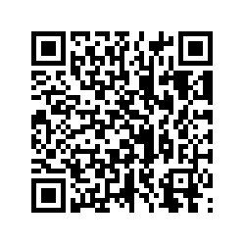
Quick Survey
We really value your feedback as it allows us to improve for the future. Please complete this 3 minute survey.
Notes:
Link for chat: https://uniofqueensland.syd1.qualtrics.com/jfe/form/SV_8j2VlfjoOBA0lEO

Slide 44

QUESTIONS?
Contact
School of Education
Room 403, Social Sciences Building (24)
The University of Queensland
E: education@uq.edu.au
P: 336 56550
W: https://education.uq.edu.au/
Office Hours
Monday/Wednesday/Friday 9:00am–1:00pm
Tuesday/Thursday 1:00pm–4:30pm
CRICOS Provider Number 00025B

